Slide 1


Why LangChain is the Core Skill for AI Developers in 2025
Live Webinar - Learn with Sarvesh
26 Oct 2025

Slide 2

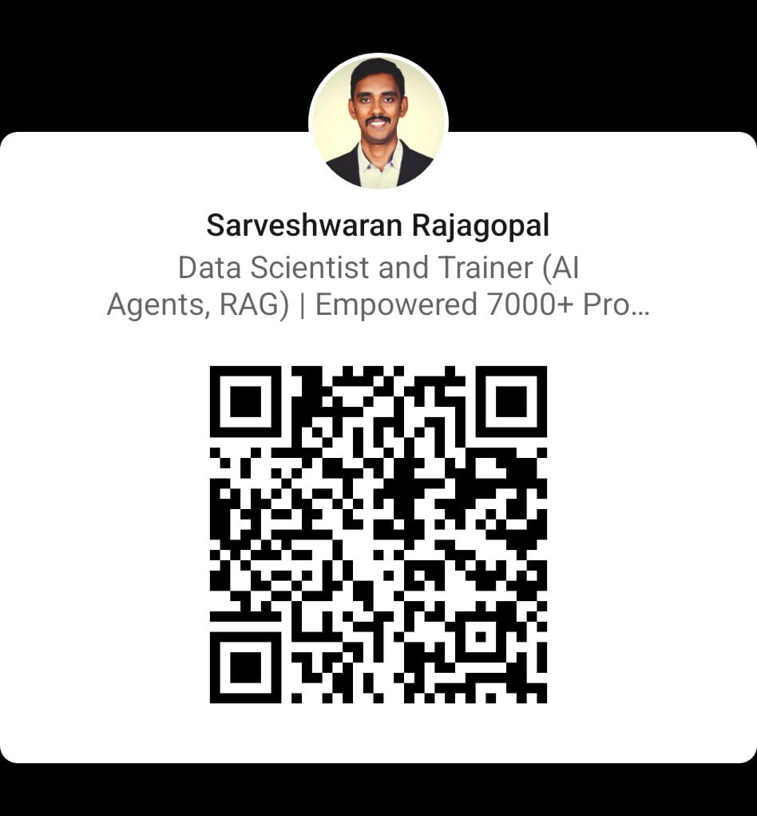

My profile
Sarveshwaran Rajagopal Data Scientist & Trainer (AI Agents, RAG) | Founder – Learn with Sarvesh Empowered 7000+ professionals & students in Data Science & AI

Slide 3
You know prompts. Now what?
You can chat with models- but can you build with them
The real challenge: making AI apps that understand your data, use tools, and give consistent results
That’s where LangChain comes in.

Slide 4
Why LLMs Alone Aren’t Enough
Can’t call APIs or fetch documents
No memory or personalization
Can’t call APIs or fetch documents
Struggles with factual answers or custom tasks
We need a framework to make LLMs useful.

Slide 5
Meet LangChain
LangChain = the developer framework for building context-aware, data-connected
LLM 🔗 Prompts 🔗 Tools 🔗 Memory 🔗 Data, tool-using AI apps.
LangChain lets you go beyond prompts — to build intelligent systems.

Slide 6
LangChain turns AI into Applications
🔍 Chatbots with memory
📚 RAG-based assistants
🧠 Agents that use APIs
📊 Document summarizers
💬 Email + content generators
If you can imagine the workflow, LangChain can chain it.

Slide 7

What You’ll Build in the LangChain Mastery Cohort
App | What It Does
AI Resume Analyzer | Parse & grade resumes using embeddings
PDF Summarizer | Local RAG-based Q&A over PDFs
AI Email Assistant | Draft emails contextually
YouTube Summarizer | Use yt_dlp + LangChain
Customer Support Bot | FAISS + ChatOpenAI
Travel Itinerary Planner | Multi-tool API Agent
🎯 Every project teaches a real LangChain concept - Chains, Agents, Memory, RAG, Tools, and APIs.

Slide 8

Live Demo: AI Resume Analyzer
Upload your resume (PDF)
LangChain extracts + embeds text
LLM grades and summarizes it

Slide 9
Demo: Resume Analyzer with LangChain

Slide 10
What Just Happened
LangChain handled the chain (Prompt + Model + Output)
You can extend it with:
🧠 Embeddings for semantic search
💾 Vector DB (FAISS/Chroma) for storing resumes
🧩 Custom grading logic or dashboards
From prompt → prototype → product → in under 50 lines of code

Slide 11
Why Every AI Developer Should Learn LangChain
Framework used by 90% of production LLM apps
Integrates with OpenAI, Anthropic, Ollama, Hugging Face
Powers RAG, Agent, and Automation systems
Essential skill for AI roles in 2025+

Slide 12
Your 12-Week Journey to AI Builder Mastery
Weeks | Focus
1–2 | LangChain Foundations
3–5 | RAG & Tools
6–8 | Agents + Integrations
9–10 | Deployments & APIs
11–12 | Capstone: End-to-End AI Assistant
By the end, you’ll have 10+ working AI projects & a GitHub portfolio that gets noticed.

Slide 13

Ask anything - code, projects, tools, or roadmap!

